Slide 1
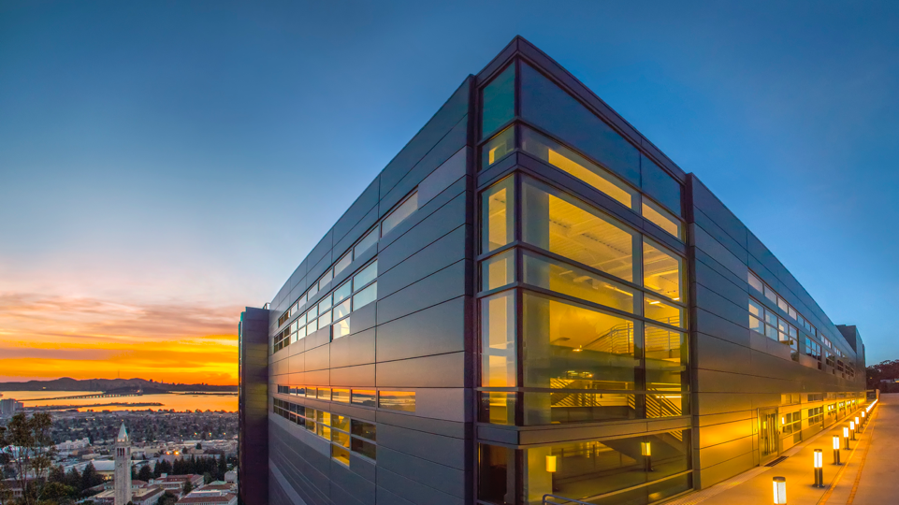
Genomic Analysis at Scale:
Mapping Irregular Computations to Advanced Architectures
Kathy Yelick
Robert S. Pepper Distinguished Professor of EECS
Vice Chancellor for Research
UC Berkeley
Senior Faculty Scientist
Lawrence Berkeley National Laboratory

Slide 2
2018 ACM Turing Award for Deep Learning
Hinton’s Turing Lecture: “So I think a lot of the credit for deep learning really goes to the people who collected the big databases like Fei Fei Li and the people who made the computers go fast like David Patterson and others.”
Yoshua Bengio Yann LeCun Geoffrey Hinton
Photo: Facebook Photo: Google Photo: Botler AI

Slide 3
Other areas where big data + big machines win?
Big Machines
Scalable Algorithms
Big Data
✓︎
Notes:
In addition to what science problem (and who cares), what data do you have/need, what algorithms, and what computing, Quantify

Slide 4
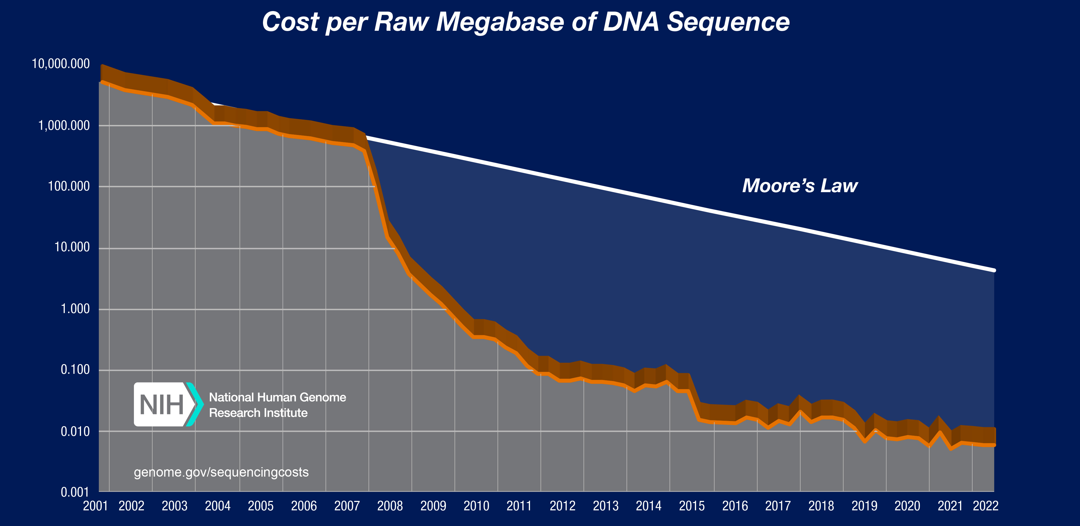
Sequencing continues to improve in cost and quality

Slide 5
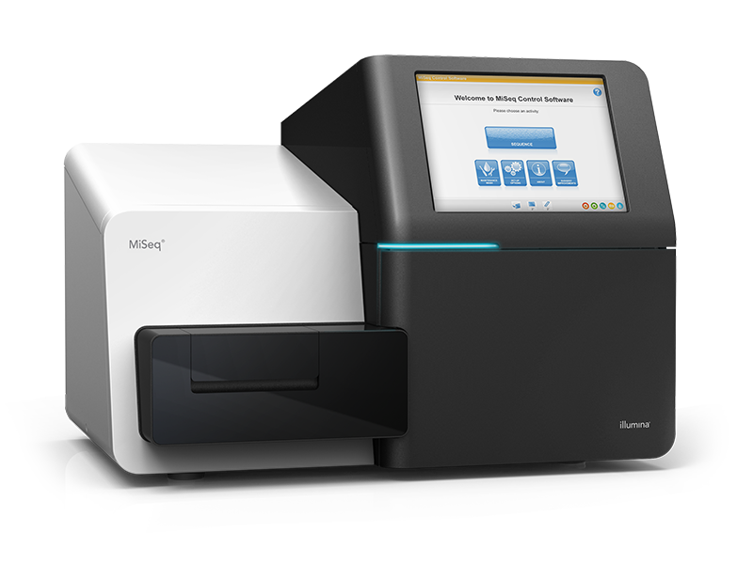
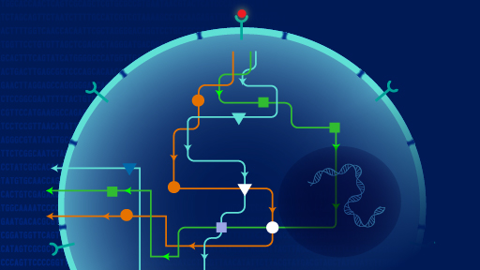
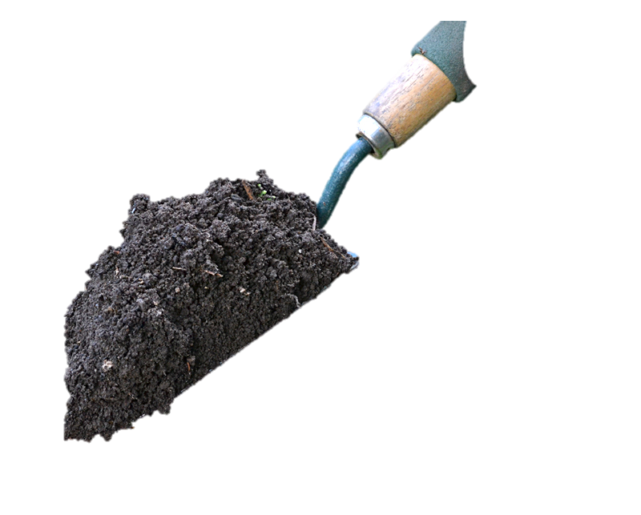
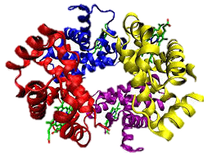
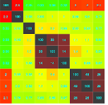
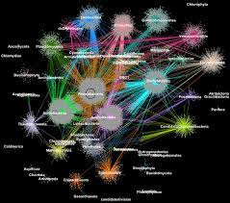
ExaBiome: Exascale Solutions for the Microbiome
Sample
?
Function
Microbial community
Structure
Sequence
Compare
Cluster
Reads
Contigs
Assemble
Bin
Find Genes
Proteins

Slide 6
De Novo Assembly is Hard

Slide 7
MetaHipMer: De Novo Metagenome Assembler

Slide 8
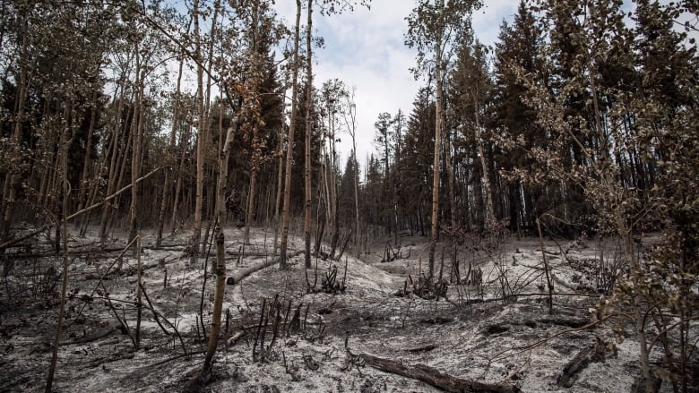


What happens to microbes after a wildfire? (1.5Terabtyes - completed)
Michael J. Wilkins, Colorado State University, PI
Notes:
The proposal, "Microbial metabolic dependency and its impacts on the soil carbon cycle", doesn't focus on any special locale, but rather the detailed dynamics of microbial activity in some general soil sample, using the stable isotope probing (SIP) technique. I grabbed a nice panel of microbial images off of Buckley's website: https://blogs.cornell.edu/buckley/
These are some of the metagenome projects from the JGI Community Science Program (CSP) that we are supporting with MetaHipMer. They look at microbial community composition and dynamics in, e.g. mixed-conifer zones following prescribed fire, seasonal and diurnal fluctuations in mangroves, and redox activity in wet tropical soils. These projects produce at least 1 TB of data, in one case up to 8 TB. They are far larger and more complex in composition than traditional metagenome datasets, a few benchmark datasets of which are shown in the table.
Show size in TB, numbers of reads, complexity (unique kmers or 21-randommer uniqueness)
Coassembly better than multiassembly

Slide 9
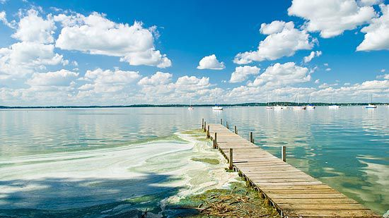
Big Science Questions
How do carbon and metabolism in freshwater lakes change across 17 years?
(26TB)
JGI-NERSC-KBase FICUS projects
Katherine McMahon, U Wisconsin, PI
Notes:
These are some of the metagenome projects from the JGI Community Science Program (CSP) that we are supporting with MetaHipMer. They look at microbial community composition and dynamics in, e.g. mixed-conifer zones following prescribed fire, seasonal and diurnal fluctuations in mangroves, and redox activity in wet tropical soils. These projects produce at least 1 TB of data, in one case up to 8 TB. They are far larger and more complex in composition than traditional metagenome datasets, a few benchmark datasets of which are shown in the table.
Show size in TB, numbers of reads, complexity (unique kmers or 21-randommer uniqueness)
Coassembly better than multiassembly

Slide 10
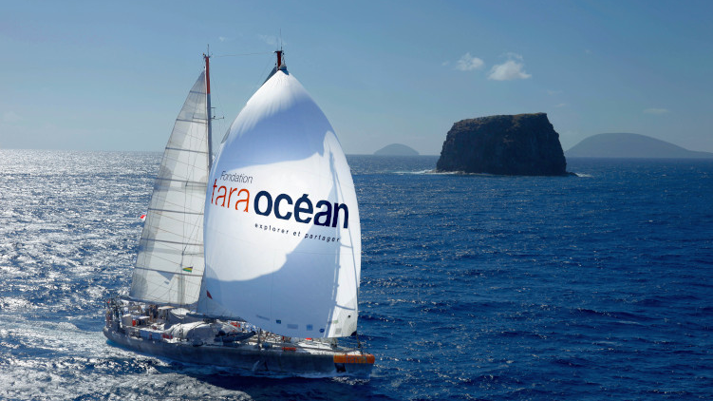
Tara Oceans
Showing the invisible life of the ocean
2009–2013 expeditions
35000 samples from all oceans
84 TB (71 TB unique) of data!
Assembled in 94 mins
Using 36,000 GPUs on Frontier
Using a Berkeley-designed language
100
Notes:
Frontier: Each node consists of one CPU, 4 GPUs and 4 terabytes of flash memory. Each GPU has 128 GB of RAM soldered onto it.

Slide 11
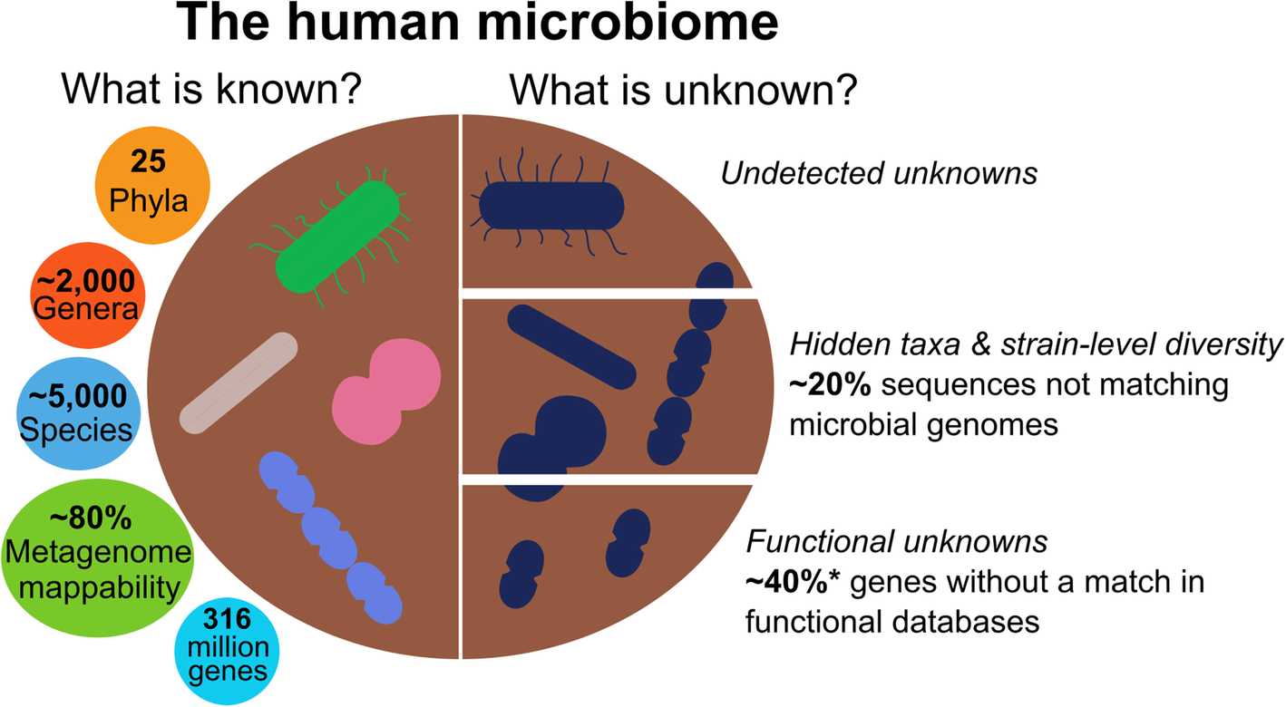
The Human Microbiome
98 TB of data!
Assembled 8/4/23
38 min on 36,000 GPUs
Thomas, A.M., Segata, N. Multiple levels of the unknown in microbiome research. BMC Biol 17, 48 (2019).
Notes:
The current knowns and unknowns in the human microbiome. Numbers of known and unknown members of the human gut microbiome taken from a population-wide and multi-bodysite large-scale metagenomic assembly study [2]. Numbers marked with asterisks refer to genes from the Integrated Gene Catalogue (IGC) of the human gut microbiome and are derived from human fecal samples and mapping to the eggNOG database [3]

Slide 12
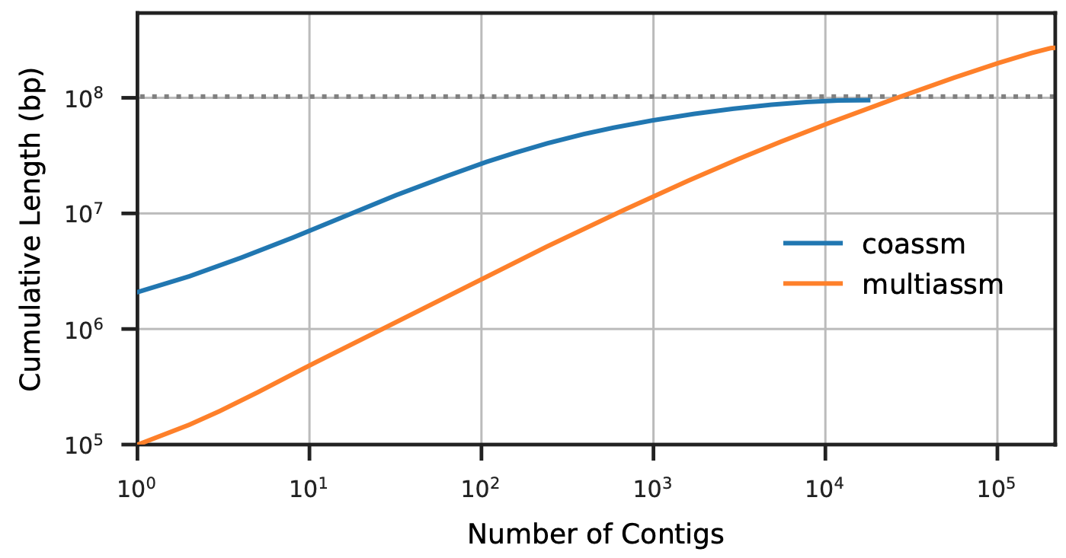
More Data Yields Better Science
Improved contiguity in coassembly
Comparable to best known assemblers on small datasets
Unique science results on large ones, co-assembled
=
800 GB of soil (Western Arctic, 12) data plus synthetic data from 64 reference genomes
Hofmeyr et al. (2020). Terabase-scale metagenome coassembly with MetaHipMer. Nature Sci Rep, 10(1)

Slide 13
Co-Assembly vs. Multiassembly: better science
Multiassembly (usual approach): Assemble each sample on a shared memory machine
CoAssembly (MetaHipMer): Assemble everything at once on a supercomputer.
Riley, el al, “Terabase-Scale Coassembly of a Tropical Soil Microbiome” Microbiol Spectr. 2023

Slide 14
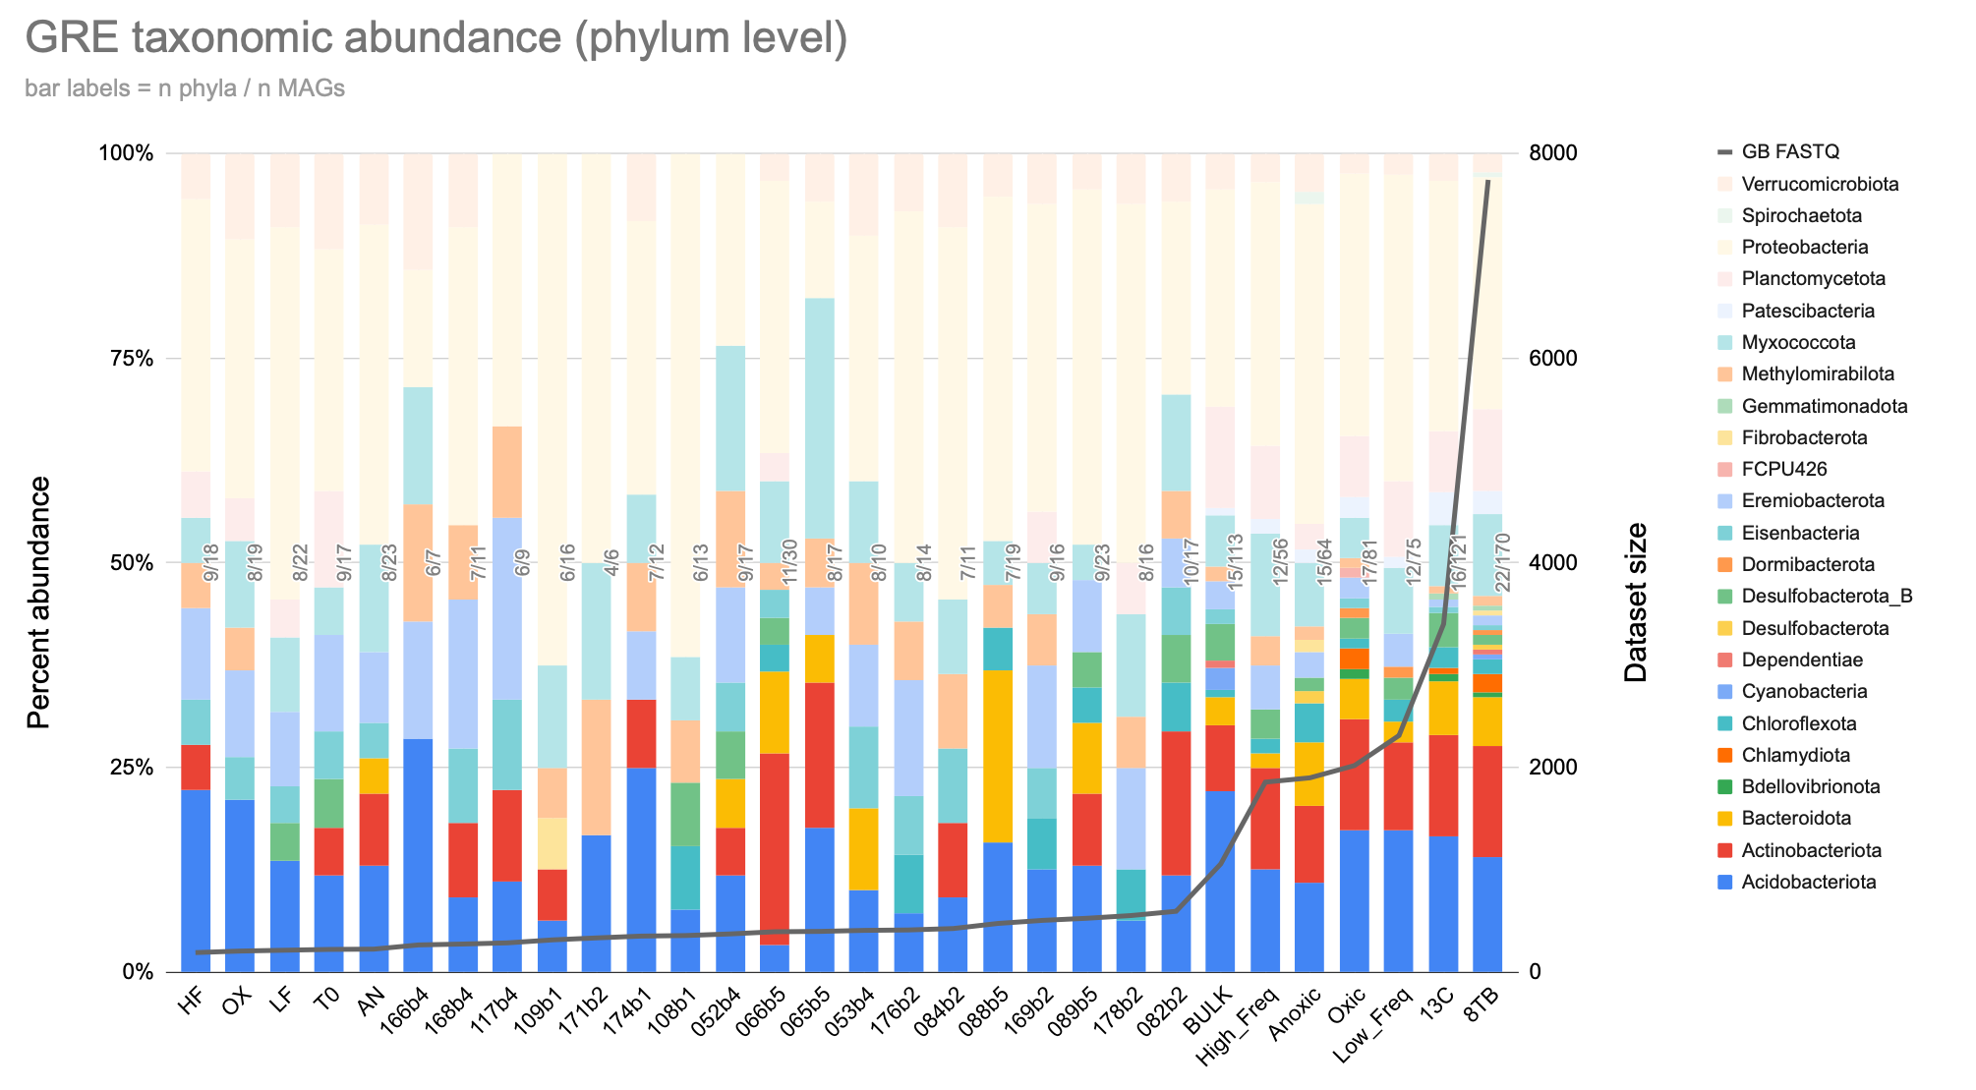
More taxonomic diversity
Unique to
>1 TB
Rare biosphere candidate phylum FCPU426 again!
Rare biosphere!
Great Redox Experiment led by Jennifer Pett-Ridge at LLNL; with Robert Riley et al at JGI and ExaBiome
Notes:
Not only do we assemble more MAGs in bigger assemblies, those MAGs represent more unique phyla
Some ten phyla are detected only in coassemblies > 1 TB
Those include, once again, the rare biosphere candidate phylum FCPU426

Slide 15
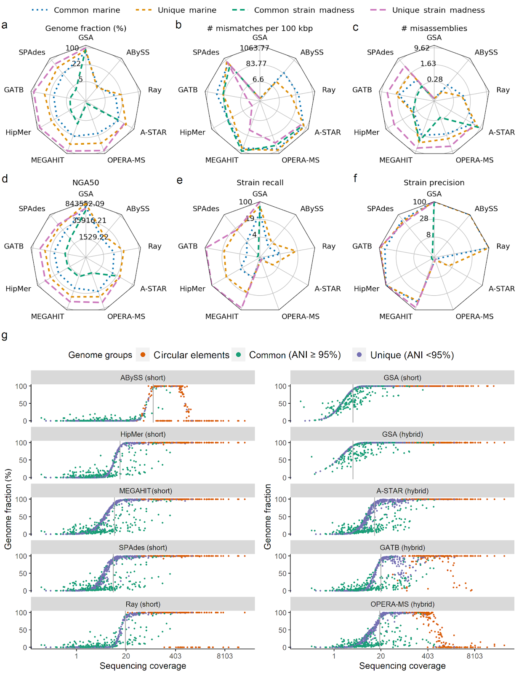

Ensuring High Quality Assemblies
Best Meta-genome Assembler
HipMer
HipMer
“... we analyze 5,002 results by 76 program versions…
The best ranking method across metrics and all datasets was [Meta]HipMer....”
F. Meyer et al, Critical Assessment of Metagenome Interpretation - the second round of challenges, Nature Methods ‘22

Slide 16
Assembly Rate on Science Data
Largest data sets require largest machines
Not just data and machine size
Over 250x on ~equal node counts!
better algorithms
less software
use of GPUs
# nodes

Slide 17
ExaBiome: Exascale Solutions for the Microbiome
Sample
?
Function
Microbial community
Structure
Sequence
Compare
Cluster
Reads
Contigs
Assemble
Bin
Find Genes
Proteins

Slide 18
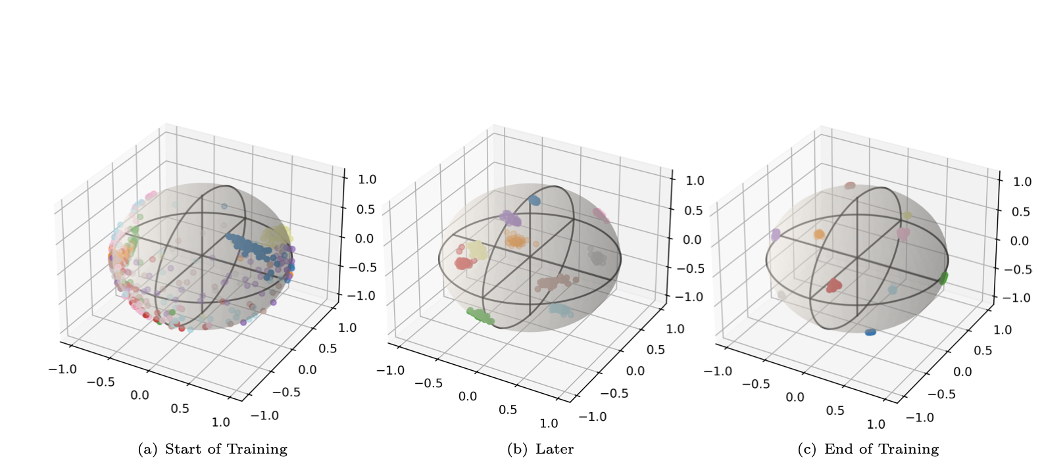
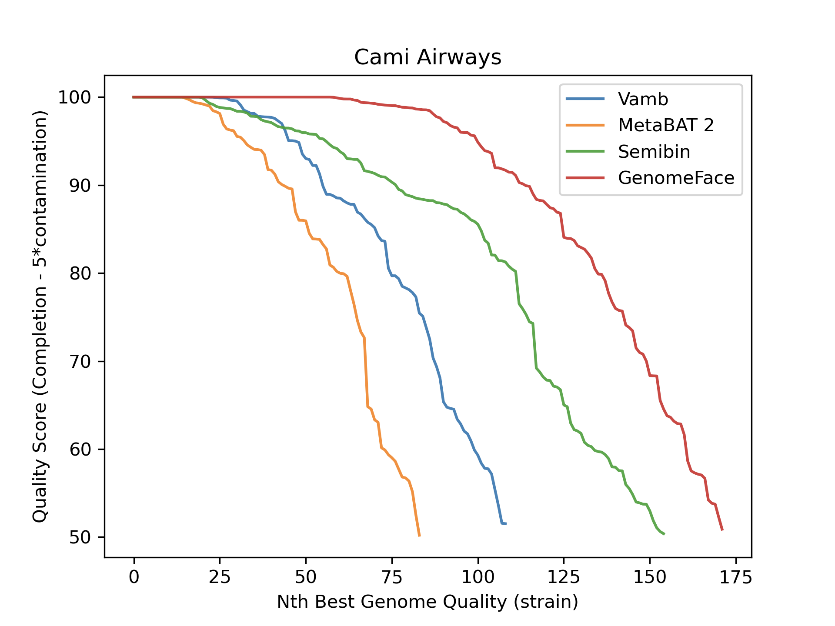
Binning with Machine Learning (GenomeFace)
Train on 43,000 genomes (k-mer frequency variants)
Learn embedding that clusters contigs from same genome
A second neural network captures relative abundance
New Science
Start Training
Quality:
End Training
Richard Lettich et al

Slide 19
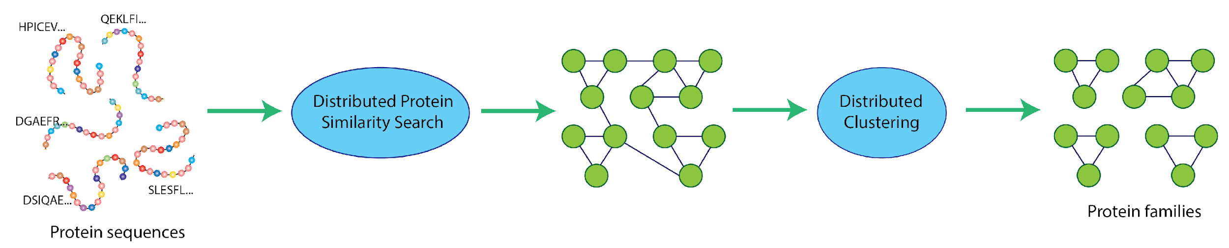

Protein Family Identification
PASTIS
HipMCL
Protein similarity network (matrix)
SC’22 Gordon Bell Finalist
Cluster homologous proteins (evolutionarily related proteins)
Construct protein similarity network using PASTIS
Use Markov Clustering using HipMCL
SC22 Gordon Bell Finalist
Oguz Sevitopi, Saliya Ekanayake, Giulia Guidi, Muaaz G Awan, Georgios A Pavlopoulos, Ariful Azad, Nikos Kyrpides, Leonid Oliker, Katherine Yelick, Aydin Buluç
Notes:
GB22: 3364 nodes of Summit > 20,000 GPUs, 3.5 hours, total vs DIAMOND: 576x Many-against-many search on 405 million sequence, Performed alignments: 8.6T
Distributed MCL: 282M proteins 37B edges (12x GPU speedup), uses COMBlas, sparse matrices

Slide 20
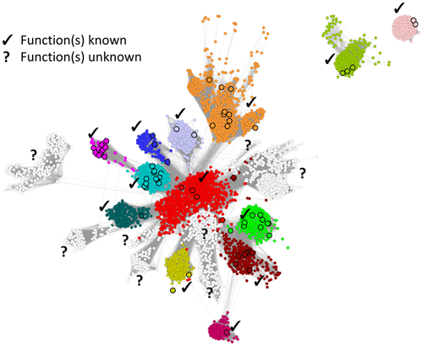

Discovery of Functional Dark Matter
Discovery, diversity and distribution of functional dark matter through global metagenomics
Forthcoming Nature paper [Pavlopoulos et al]
ExaBiome work led by Aydin Buluç with Oguz Selvitopi, Ariful Azad

Slide 21
Other areas where big data + big machines win?
Big Machines
Scalable Algorithms
Big Data
✓︎
Notes:
In addition to what science problem (and who cares), what data do you have/need, what algorithms, and what computing, Quantify

Slide 22
Exascale Architecture Plans (2008)
Accelerators (GPUs)
100x more cores
100x Faster clocks

Slide 23

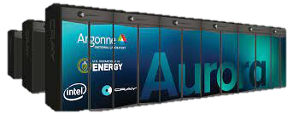
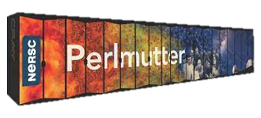
Exascale Architecture Plans (2021)
US DOE Office of Science Systems
Exascale
HPE AMD+AMD
Exascale
HPE Intel+Intel
Pre-exascale
HPE AMD+NVIDIA

Slide 24

Accelerators
Image: http://slideplayer.com/slide/7541288/
Notes:
Xeon Phi Main – using Phi as main processor = not strictly a co-processor or accelerator

Slide 25
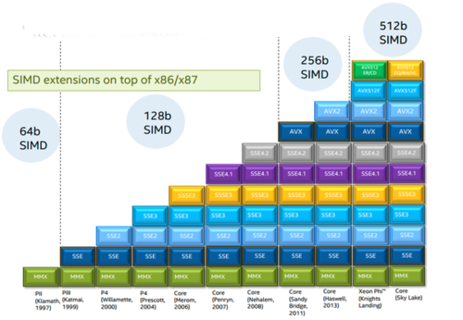
Wider SIMD
Fugaku Machine
ARM w/ 512b

Slide 26
Specialization: End Game for Moore’s Law
Ops/Joule
General Purpose
GPUs
Special Purpose

Slide 27
Notes:
https://github.com/basicmi/AI-Chip
>4B VC investment

Slide 28
Is deep learning the only application?
Cautionary tale from HPL

Slide 29
Data Movement is Expensive
Hierarchical energy costs.
6 pJ
Cost to move data 1 mm on-chip
100 pJ
Typical cost of a single floating point operation
120 pJ
Cost to move data 20 mm on chip
250 pJ
Cost to move off-chip, but stay within the package (SMP)
2000 pJ
Cost to move data off chip into DRAM
~2500 pJ
Cost to move data off chip to a neighboring node
Image: http://slideplayer.com/slide/7541288/
Notes:
From: OpenSoC Fabric slides. Farzad Fatollahi-Fard

Slide 30
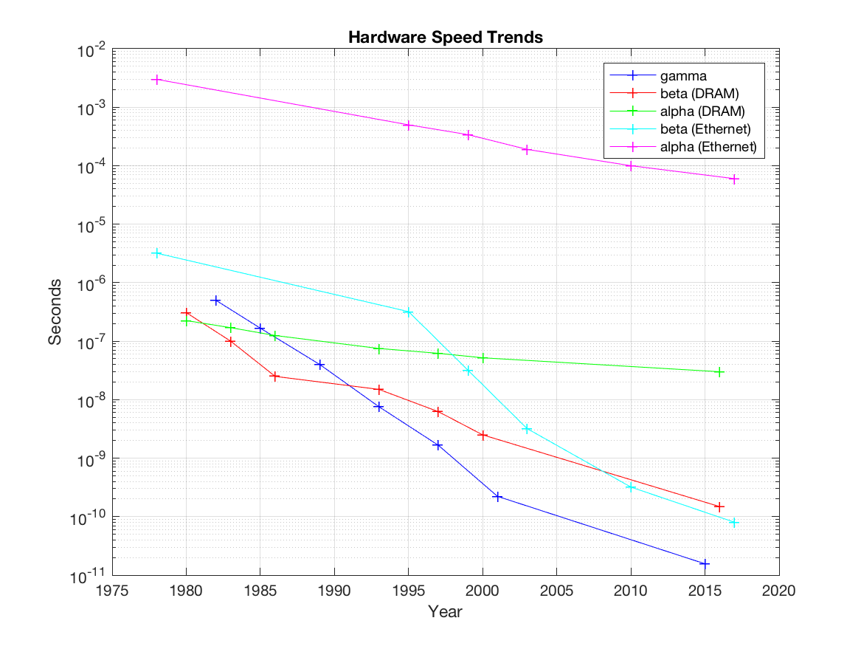
Communication Dominates: Dennard was too good
network latency (α)
Time =
# flops * γ +
# message * α +
# bytes comm * β +
# diff memory locs * α2 +
# memory words * β2
network bandwidth (β)
memory latency (α2)
DRAM bandwidth (β2)
flop (γ)
Data from Hennessy / Patterson, Graph from Demmel

Slide 31
Put the GPUs in Charge
GPU
CPU
CPU
GPU
Memory
Memory
More cores
Narrow data types
CPUs in control
CPUs communicate
More memory spaces
More data parallelism

Slide 32
Genomic Analysis at Scale
Big Machines
Scalable Algorithms
Big Data
✓︎
Notes:
In addition to what science problem (and who cares), what data do you have/need, what algorithms, and what computing, Quantify

Slide 33
MetaHipMer Assembly Pipeline (UPC++)
reads
1) K-mer Analysis K-mer histogram
SC’18 Best Paper Finalist
1
Iterate for k+s
k-mers
2) Contig Generation Walk k-mer graph
2
Extract k+s-mers
contigs
3) Alignment Align reads to contigs
3
read-contig
alignments
4) Local Assembly
Extend ends of contigs
extended
contigs
4
contig-contig scaffolds
5
5) Scaffolding
Walk contig graph (iterate)
Actual pipeline is more complex, simplified for purpose of presentation
Evangelos Georganas, S. Hofmeyr, L. Oliker, R. Egan, D. Rokhsar, A. Buluc, K. Yelick, SC’18
33
Notes:
Meta: avoiding using terminology beyond “read”, “kmer”, and “contig”.

Slide 34
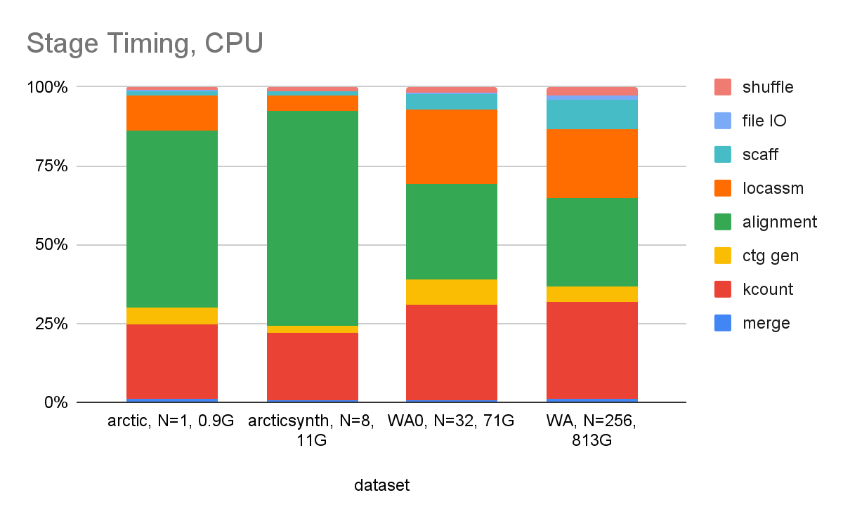
MetaHipMer Time Breakdown
Weak-ish scaling
arctic | arcticsynth | WA0 | WA
N=1 (0.9GB) | N=8 (11GB) | N=32 (71GB) | N=256 (813GB)
* CPU time for alignment slower than “normal” due to SIMD Power9 issues

Slide 35
Simulation Vs. Data Motifs
7 Dwarfs of Simulation | 7 Giants of Big Data
Particle methods | Generalized N-Body
Unstructured meshes | Graph-theory
Dense Linear Algebra | Linear algebra
Sparse Linear Algebra | Optimization
Spectral methods | Integrations
Structured Meshes | Alignment
Monte Carlo methods | Basic Statistics
Hashing
Sorting
Phil Colella
NRC Report + our paper
Yelick, et al. “The Parallelism Motifs of Genomic Data Analysis”, Philosophical Transactions A, 2020

Slide 36
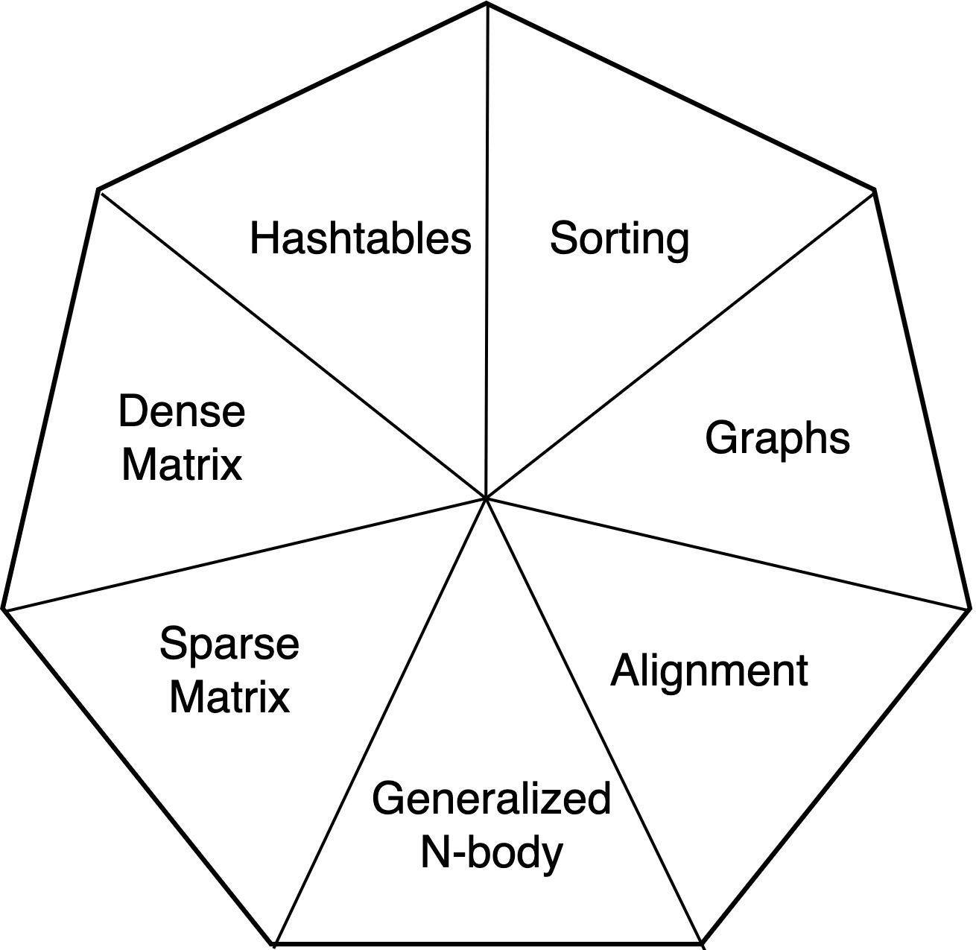
Motifs of Genomic Data Analysis
Computational patterns that dominate ExaBiome
Examples
Hash all k-mers (k-length strings)
Count k-mer frequency
Identify connected components
Find all pairwise alignments
Average neighbors on graph
Yelick, et al. “The Parallelism Motifs of Genomic Data Analysis”, Philosophical Transactions A, 2020
Notes:
DL:
To address these limitations, we are exploring the use of deep neural networks for predicting gene class and species of new sequences. i.e. Instead of indexing a large database, can we train a neural network to learn the gene and species landscape?
Although we think of genes and species as “classes”, there exists continuity among these classes. Genes and species exist in a complex manifold, rather than 10 thousand bins. Teaching a neural network to learn this requires us to convert known genes/species into continuous-values, which we can regress onto sequences. Currently, we are exploring the use of manifold learning methods to create these labels, and may explore neural networks for creating these embeddings.
Finally, determining the right network architecture is also being investigated. We’re looking at 1D Convolutional Neural Networks, and maybe LSTMs if the CNNs aren’t successful

Slide 37
A Tale of Two Programming Models for Irregular (Genomics) Applications
Partitioned Global Address Space (UPC++) | GraphBLAS and MPI
Asynchronous, fine-grained | Bulk Synchronous
Distributed data | Sparse matrix with semiring operations
Logically shared, physically distributed | Local view, distributed
MetaHipMer, KmerProf | PASTIS, HipMCL, diBELLA, ELBA

Slide 38
Hashing
Notes:
Completely rethink hardware, sotwarre, algorithms, applkications (deep in each)
All the way up to the problem statement

Slide 39
Counting K-mers to Remove Errors
}
GCTA C GGAATAAAACCAGGAACAACAGACCCAGCAC
...
ATTAACAACAAAGGGTAAAAGGCATCATGGCTTCAG
reads
GCAGAAAATGGGAGTGAAAATCTCCGATGAGCAGCT
TGATGCGACGACGCACCTCGTTGTTACGCACTTCAG
}
GCTA
ACGG
AACC
GAAT
TAAA
k-mers
(e.g. k=4)
...
CTAC
ACCA
CGGA
AATA
AAAA
TACG
AAAC
CCAG
GGAA
ATAA
Notes:
Necessary vocabulary
Inputs are reads
k-mers are substrings of reads, parsed by sliding a window of length k over the reads, 1 base at a time

Slide 40
Distributed Hash Tables of K-Mers
Make hash table of k-mers
Keys are fixed-length strings:
Values depend on application:
A count to remove singletons
Close to k-times memory blowup
Use Bloom filter to reduce space
Asynchronous insert with UPC++
AAC TGA CCG
ACC GAT CGT
CCT ATT GTC
1-sided communication to insert / lookup

Slide 41
K-mer counting: All the Wires All the Time
MPI with bloom filter
UPC++ with bloom filter
UPC++ without
Bulk-synchronous MPI vs Asynchronous 1-sided UPC++ (w/ and w/out Bloom Filter)
Steve Hofmeyr, Rob Egan, Evangelos Gerganas, leads on MetaHipMer software

Slide 42
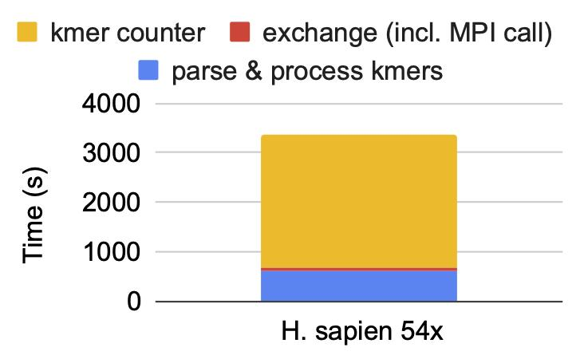
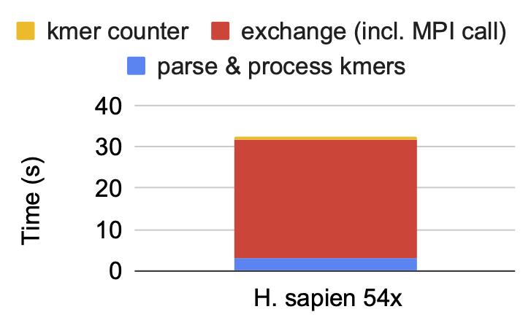
K-mer Counting: Finding Data Parallelism
64 nodes (2688 CPU cores)
64 notes (384 GPUs)
K-mer counter on Summit. (Note scales -- red k-mer exchange time is roughly equal.)
Reduce CPU/GPU communication by parsing as well as processing on GPU
Over 100x speedup!!
Israt Nisa, P. Pandey, M. Ellis, L. Oliker, A. Buluç, K. Yelick. Distributed-Memory k-mer Counting on GPUs. IPDPS ‘21 (to appear)

Slide 43
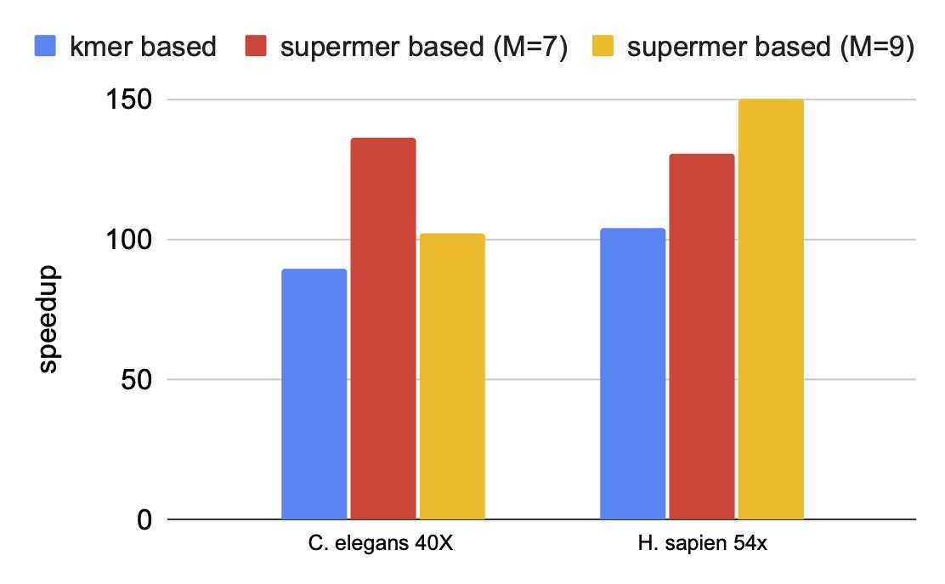
K-mer Counting: Reducing Communication
Read: ACTGGACTGCTGCGAGTGA
ACTGGACT
CTGGACTG
TGGACTGC
GGACTGCT
GACTGCTG
ACTGCTGC
CTGCTGCG
TGCTGCGA
GCTGCGAG
CTGCGAGT
TGCGAGTG
GCGAGTGA
Minimizer: ACTG
Supermer:
ACTGGACTGCTGC
Minimizer: CTGC
Supermer:
CTGCTGCGAGT
Minimizer: AGTG
Supermer:
TGCGAGTGA
Reduce communication with “Supermers”
Multiple contiguous k-mers (k=7, minimizer=4)
map to the same process ID with minimizer-based hashing
Saves volume (bandwidth) and number of messages (latency)
Speedup on 64 Summit nodes
6 GPUs / node
baseline: 42 cores / node
Israt Nisa, P. Pandey, M. Ellis, L. Oliker, A. Buluç, K. Yelick. Distributed-Memory k-mer Counting on GPUs. IPDPS ‘21 (to appear)

Slide 44
Universal Filter for GPUs
Filter | Insert |  | Query |  | Delete |  | Count
 | Point | Bulk | Point | Bulk | Point | Bulk | Point | Bulk
GQF | ✓ | ✓ | ✓ | ✓ | ✓ | ✓ | ✓ | ✓
TCF | ✓ | ✓ | ✓ | ✓ | ✓ | ✓
BF | ✓ | ✓ | ✓ | ✓
SQF |  | ✓ |  | ✓ |  | ✓
RSQF |  | ✓ |  | ✓
Our GPU Quotient Filter (GPU) is fully featured:
Deletions and Counts
Individual element operations (Point) and aggregate (Bulk)
Led by Prashant Pandey with Hunter McCoy at U. Utah

Slide 45
GQF Performance on Multi-GPUs
inserts
positive queries
random queries
point
bulk
Saves ½ of peak memory usage in MetaHipMer relative to no filter
Saves ½ of communication in K-mer counting phase relative to bloom filter
McCoy, et al. “High-Performance Filters for GPUs” PPoPP '23

Slide 46
Graphs
Notes:
Completely rethink hardware, sotwarre, algorithms, applkications (deep in each)
All the way up to the problem statement

Slide 47
Avoiding Communication in Graph Walk
Next step in this assembler is a DFS on the k-mer graph (edges are k-1 overlaps)
Caching for temporal locality (reuse): if few large items, so lookups will repeat
Layout for spatial locality: if we have an “oracle” that approximate final genome
P₁
CCG
P₀
ACC
AAC
Traversal is up to 2.8x faster!
Up to 76% reduction of off-node communication !
GAT
ATC
TCT
CTG
TGA
AAT
ATG
P₂
TGC
Georganas PhD Thesis and SC18 paper

Slide 48
K-Mer Hash Tables Viewed as a Graph
Make hash table of k-mers
Keys are fixed-length strings
Values
Remove branches
Find connected component “contigs”
Graph walk with poor locality
Asynchronous lookup with UPC++
AAC TGA CCG
ACC GAT CGT
CCT ATT GTC
1-sided communication to insert / lookup

Slide 49
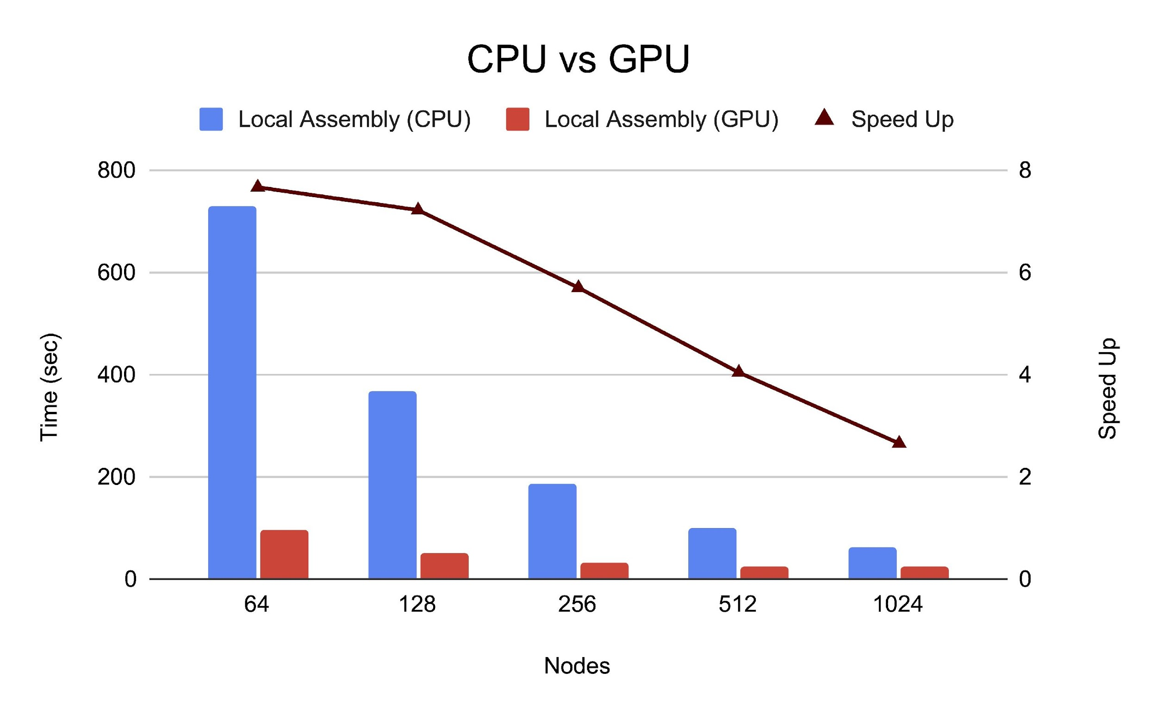
Local Assembly on Summit
Speedup of 7x on 64 Summit nodes.
Communication dominates at higher scale
SC’21 Best Paper Finalist
Muuz Awan et al, “Accelerating Large Scale de Novo Metagenome Assembly Using GPUs” SC’21

Slide 50
Asynchronous Parallelism on GPUs
Related work: Broker queue by Kerble et al
Warp-size or Thread-group (CTA)-size workers
Locking vs Compare-And-Swap (CAS) implementations
Avoid level-by-level synchronization
Use persistent threads as an option
Yuxin Chen, B. Brock, S. Porumbescu, A. Buluc, K. Yelick, John Owns, ICPP ‘22

Slide 51
Asynchronous Graph Algorithms in ATOS
Compare to state-of-the-art GPU graph frameworks:
Gunrock and Groute on single node;
Galois on multiple nodes
Yuxin Chen, B. Brock, S. Porumbescu, A. Buluc, K. Yelick, John Owns, ICPP ‘22

Slide 52
Alignment
Notes:
Completely rethink hardware, sotwarre, algorithms, applkications (deep in each)
All the way up to the problem statement

Slide 53
Smith-Waterman: Dynamic Programming
Scoring
insert/delete = -2
match = 1
mismatch = -1.
 | _ | G | A | T | C | A | G | C | T
_ | 0 | 0 | 0 | 0 | 0 | 0 | 0 | 0 | 0
G | 0 | 1 | 0 | 0 | 0 | 0 | 0 | 0 | 0
A | 0 | 0 | 2 | 0 | 0 | 1 | 0 | 0 | 0
T | 0 | 0 | 0 | 3 | 1 | 0 | 0 | 0 | 1
A | 0 | 0 | 1 | 1 | 2 | 2 | 0 | 0 | 0
G | 0 | 0 | 0 | 0 | 2 | 1 | 3 | 1 | 0
C | 0 | 0 | 0 | 0 | 1 | 1 | 2 | 4 | 2
C | 0 | 0 | 0 | 0 | 1 | 0 | 2 | 3 | 3
GATCACCT
GAT_ACCC
Options to search matrix
Full search (Smith-Waterman)
Banded (only search near diagonal)
X-Drop stop poor searches early
Many variations

Slide 54
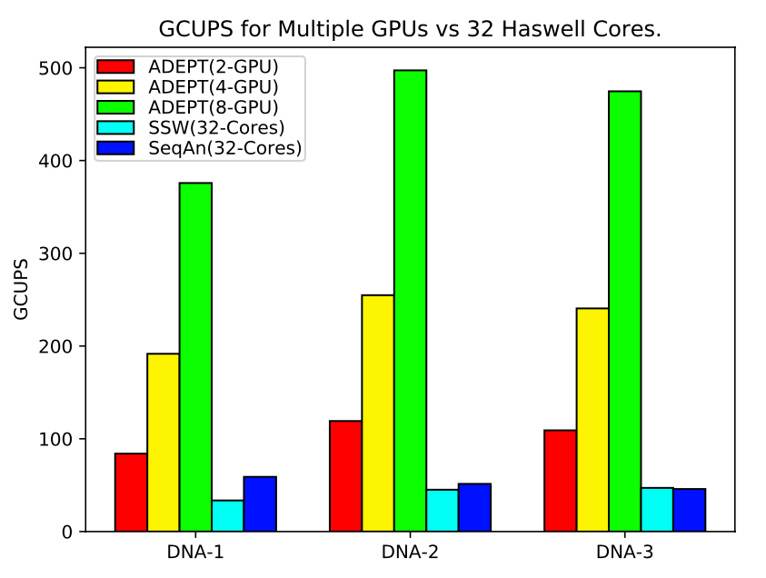
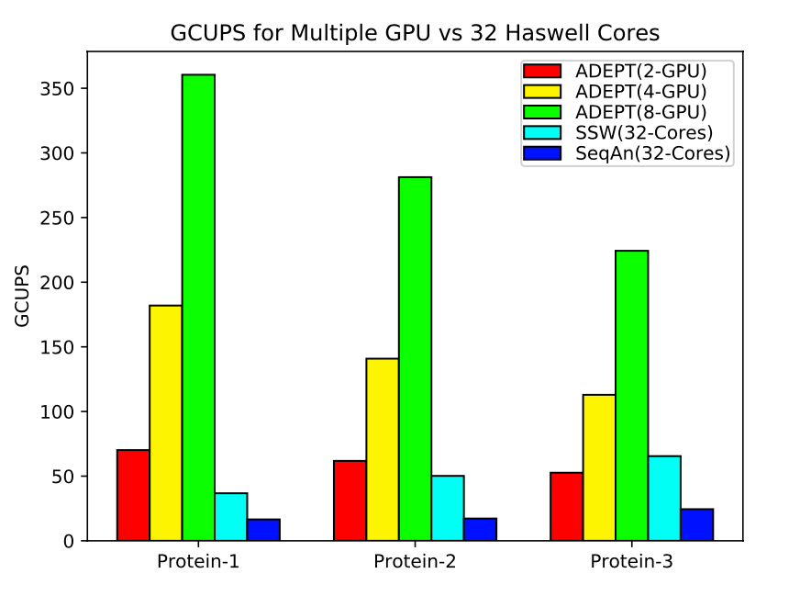
ADEPT: Batch Alignment on GPUs
GCUPS = Giga-Cell Updates per second
Adept is designed for relatively short, low-error sequences, both DNA (left) and proteins (right)
SSW and SeqAn are vectorized implementations of Smith-Waterman Algorithm on CPU.
Muaaz Awan et al, “ADEPT….” BMC Bioinformatics 21

Slide 55
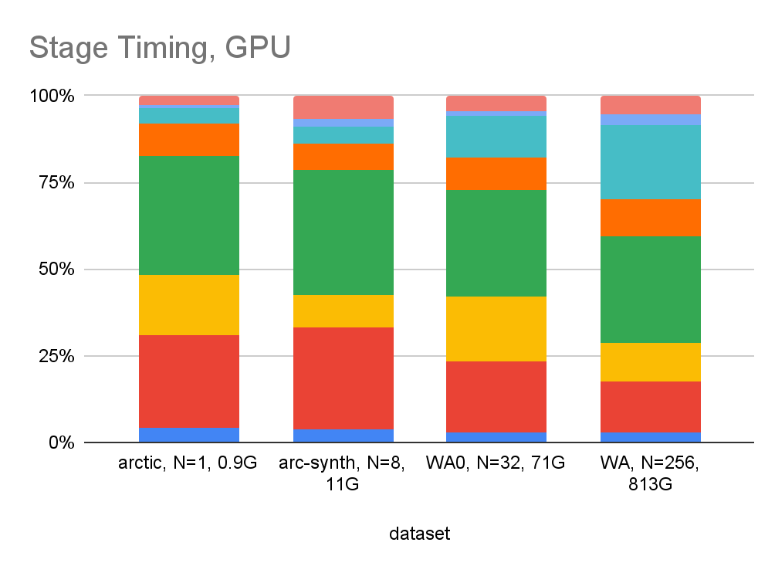
MetaHipMer Time Breakdown
arctic | arcticsynth | WA0 | WA
N=1 (0.9GB) | N=8 (11GB) | N=32 (71GB) | N=256 (813GB)
GPU optimized
arctic | arcticsynth | WA0 | WA
N=1 (0.9GB) | N=8 (11GB) | N=32 (71GB) | N=256 (813GB)

Slide 56
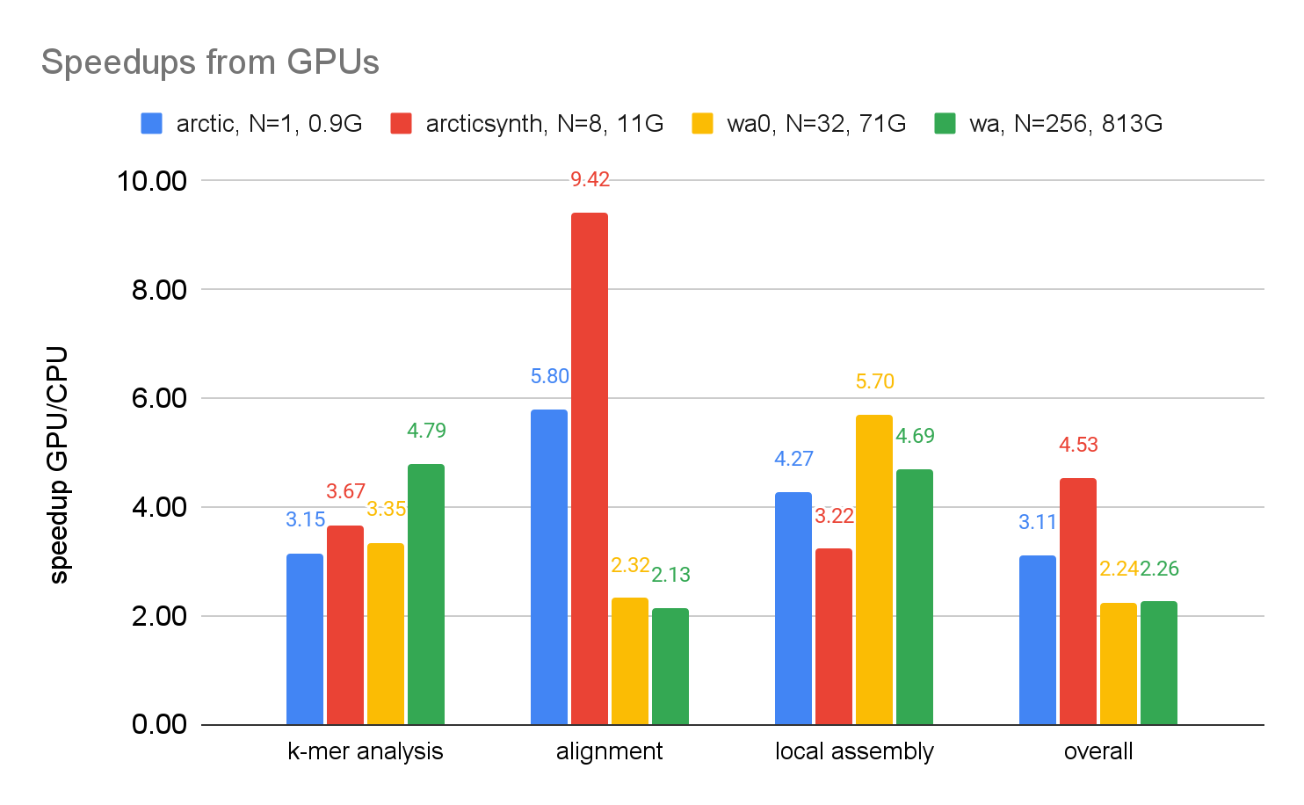
GPU Optimizations
GPU optimizations are complex (hash tables, graphs, etc.)
SC’21 Best Paper Finalist
Muaaz Awan, J. Deslippe, S. Hofmeyr, R. Egan, A. Buluç, L. Oliker, K. Yelick, SC21

Slide 57
Generalized N-Body
Notes:
Completely rethink hardware, sotwarre, algorithms, applkications (deep in each)
All the way up to the problem statement

Slide 58
ELBA: Long Read Assembler; Different Approach
Long reads (PacBio, etc.)
Longer alignments
More compute-intensive
More GPU friendly
Only align pairs of reads that have a common k-mer

Slide 59
Set Alignment is a Sparse All-to-All
Run expensive alignment on all pairs with a common k-mer

Slide 60
Bulk-Synchronous vs 1-sided Asynchronous
Asynchronous communication
Hides latency and uses less memory in general
Uses “All the wires, all the time”
But uses linear communication, not log-p complexity collectives
Marquita, Ellis, Giulia Guidi, et al. “DiBELLA….” ICPP ‘19

Slide 61
Avoid Communication, Maximize Parallelism
Compute on all pairs of particles or strings, or…
Obvious solution
Better solution
16 particles on 8 processors
Pass all particles around (p steps)
Decreases
#messages by factor c²
#volume sent by factor c
c = 4 copies of particles
8 particles on each
Michael Driscoll et al, “A Communication-Optimal N-Body Algorithm for Direct Interactions” IPDPS ‘13

Slide 62
1D vs 2D Algorithm on DNA “overlap”
Lower is Better
G. Guidi, O. Selvitopi†, M. Ellis, L. Oliker, Y, A. Buluc (IPDPS ‘21)

Slide 63
Sparse and
Dense Matrices
(machine learning)
Notes:
Completely rethink hardware, sotwarre, algorithms, applkications (deep in each)
All the way up to the problem statement

Slide 64
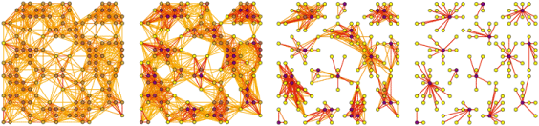
Protein Clustering with Sparse Matrices
Input: Adjacency matrix A (sparse)
Image source: http://micans.org/mcl/
Initial network
Iteration 1
Iteration 2
Iteration 3
Similarity Matrix: “Many-to-many” protein alignment
Expansion: Square matrix, pruning small entries, dense columns
Inflation: element-wise powers
PASTIS + HipMCL
Oguz Selvitopi; Md Taufique Hussain; Ariful Azad; Aydın Buluç

Slide 65
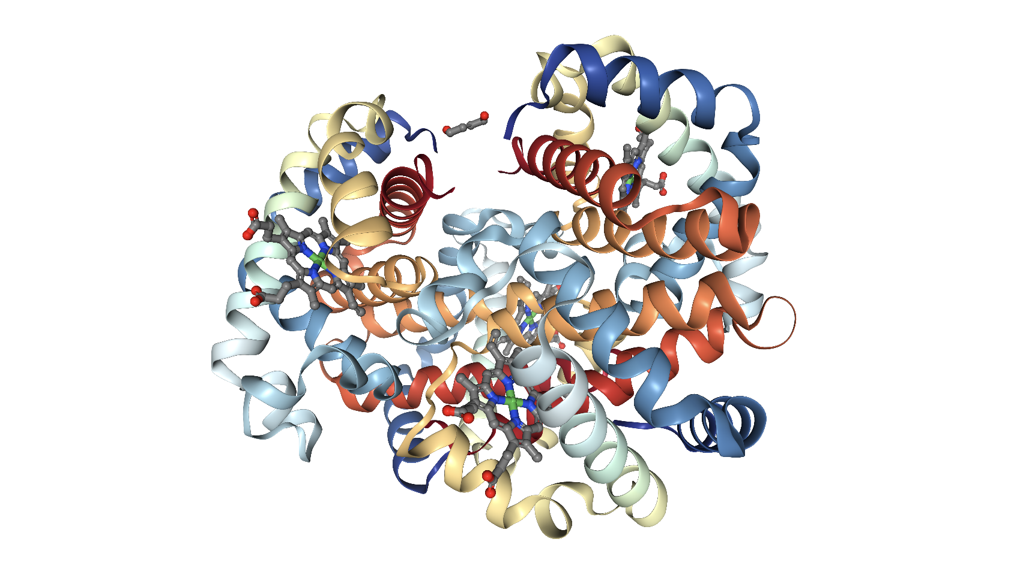
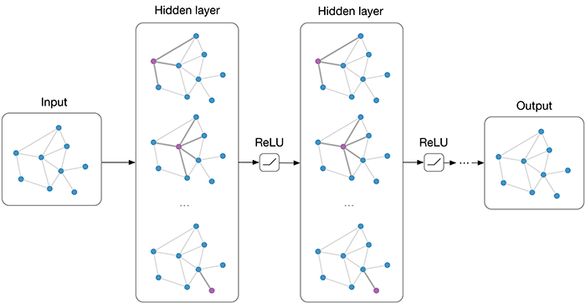
Learning protein funding using GNNs
Exploit structure and sequence to understand the function
of protein-coding genes
PersGNN by Swensen, Krishnapriyan, Buluc, Morozov, Yelick

Slide 66
Bottleneck in GNN Training
W^{l}
Z^{l}
A^{T}
H ^{l-1}
A^{T}H ^{l -1} sparse-dense matmul (SpMM)
(A^{T}H ^{l -1}) W^{l} dense-dense matmul (DGEMM)
SpMM is the bottleneck, not DGEMM!

Slide 67
Communication-Avoiding Matrix Multiply
x
k
y
2D algorithm: never chop k dim
3D: Assume + is associative; chop k, which is → replication of C matrix
z
y
z
j
x
i
Matrix Multiplication code has a 3D iteration space
Each point in the space is a constant computation (*/+)
for i
for j
for k
C[i,j] …
A[i,k] …
B[k,j] …

Slide 68
Avoiding Communication in GNNs
1D
1.5D
2D
3D
1.5D c =
Tripathy, Yelick, Buluc, Reducing Communication in Graph Neural Network Training, SC’20

Slide 69
Machine Learning Mapping to Linear Algebra
Logistic Regression, Support Vector Machines
Dimensionality Reduction (e.g., NMF, CX/CUR, PCA)
Clustering (e.g., MCL, Spectral Clustering)
Graphical Model Structure Learning (e.g., CONCORD)
Deep Learning (Convolutional Neural Nets)
Sparse Matrix-Sparse Vector (SpMSpV)
Sparse Matrix-Dense Vector (SpMV)
Sparse Matrix Times Multiple Dense Vectors
(SpMM)
Sparse - Sparse Matrix Product
(SpGEMM)
Dense Matrix Vector
(BLAS2)
Sparse - Dense Matrix Product
(SpDM³)
Dense Matrix Matrix (BLAS3)
Increasing arithmetic intensity
Aydin Buluc, Sang Oh, John Gilbert, Kathy Yelick

Slide 70
Take-Aways Messages
Science
More data, more compute → more insights
Previously impossible computations (only shared memory)
First ever assemblies, new species, new functional protein families
New DOE facility capability (JGI)
Programming models
Use of PGAS for irregular, asynchronous problems with GPUs
Sparse matrix abstraction
Algorithms
Use memory to reduce data movement (volume)
Hardware
Use of accelerators, but need to integrate communication

Slide 71

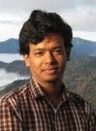
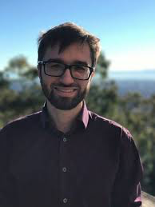
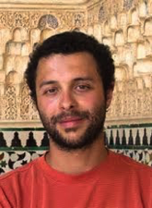
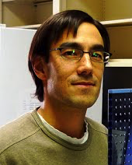
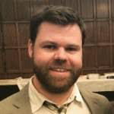
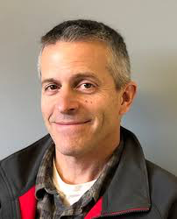
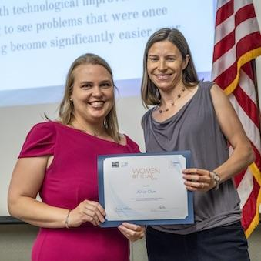
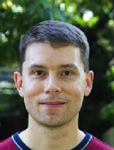
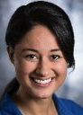
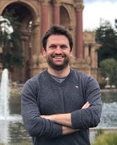
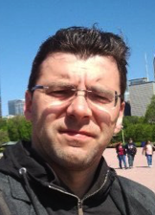
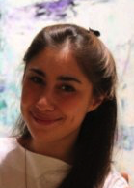
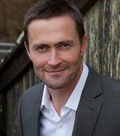
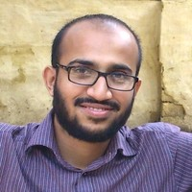























The ExaBiome Team
Muaaz Awan | Ariful Azad | Nick Battacharya | Aydin Buluc | Patrick Chain | Brandon Cook | Alex Copeland | Alicia Clum | Rob Egan
Marquita Ellis | E. Georganas | E. Goltsman | Giulia Guidi | Steve Hofmeyr | Taufique Hussain | Richard Lettich | Nikos Kyrpides | J. Madson
Hunter McCoy | Russell Neches | Israt Nisa | Lenny Oliker | P. Pandey | Robert Riley | Dan Rokhsar | Gabriel Raulet | Oguz Selvitopi
Migun Shakya | Nick Swenson | Andrew Tritt | Kathy Yelick | Brett Youtsey

Slide 72


